Slide 1
Vendor Training Session #4 Bid Opening and Award

Slide 2
Objectives
Why BidBuy
Bid Opening and Award
BAFO
Acknowledging Award
Contract Execution
Ship To/Bill To – Header or Sub-Tab
Purchase Orders
Change Orders

Slide 3
Why BidBuy?
Simplifies the bid/quote process by allowing electronic submittals.
Reduces paper documentation and records.
Centralizes state procurement communications in a single location.
Allows vendors to easily review open bids, submit bids/quotes and receive awards from a central location.
Allows vendors to review its procurement history.

Slide 4
BAFO (Best and Final Offer)
Agency will open the bid, conduct evaluation and any BAFO.
The BAFO process will occur between agency and the vendor.
BAFO documentation and pricing will be included in BidBuy.

Slide 5
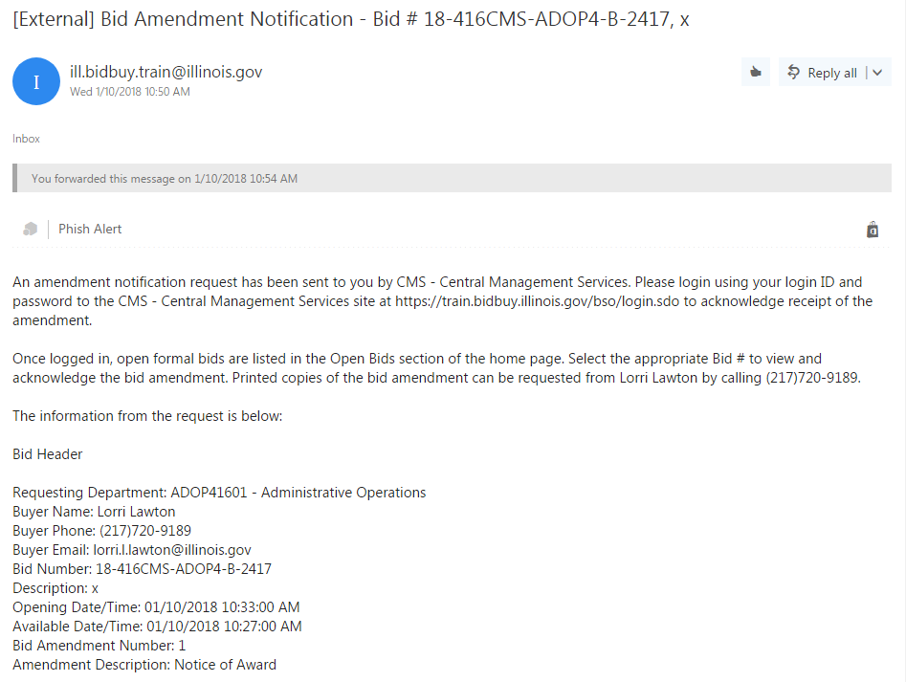
Notification of Award
At the award of the bid, an email is sent to notify vendors of the State’s intent to award.
Notes:
Verify who gets this email.

Slide 6
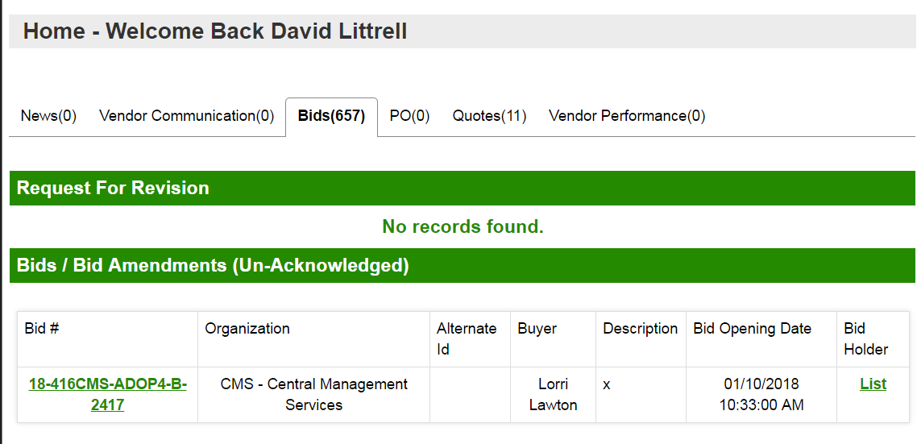
Acknowledging Amendment
Login to BidBuy.

Slide 7
Acknowledging Amendment
Click to Acknowledge amendment
Notes:
Demo Bid Tab

Slide 8
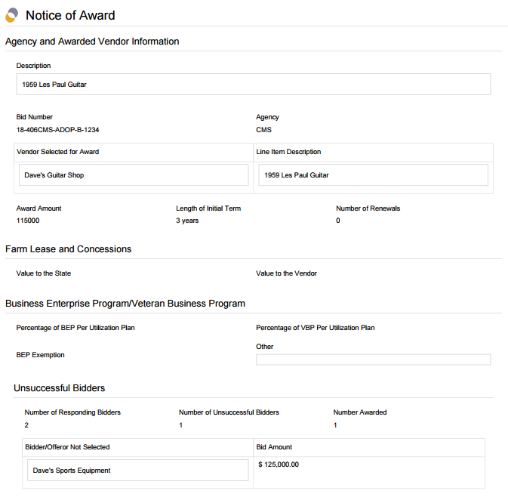
Notice of Award Form

Slide 9
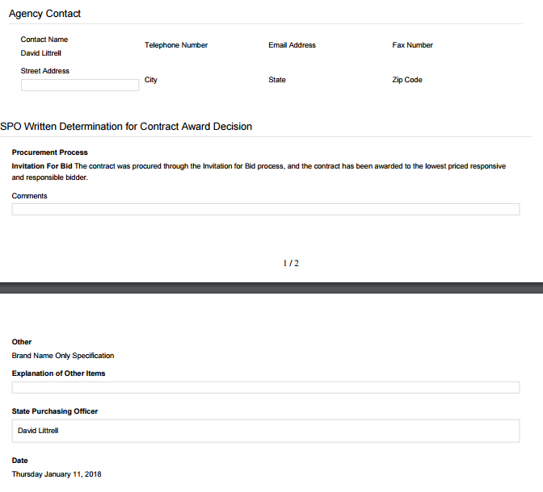
Notice of Award Form

Slide 10
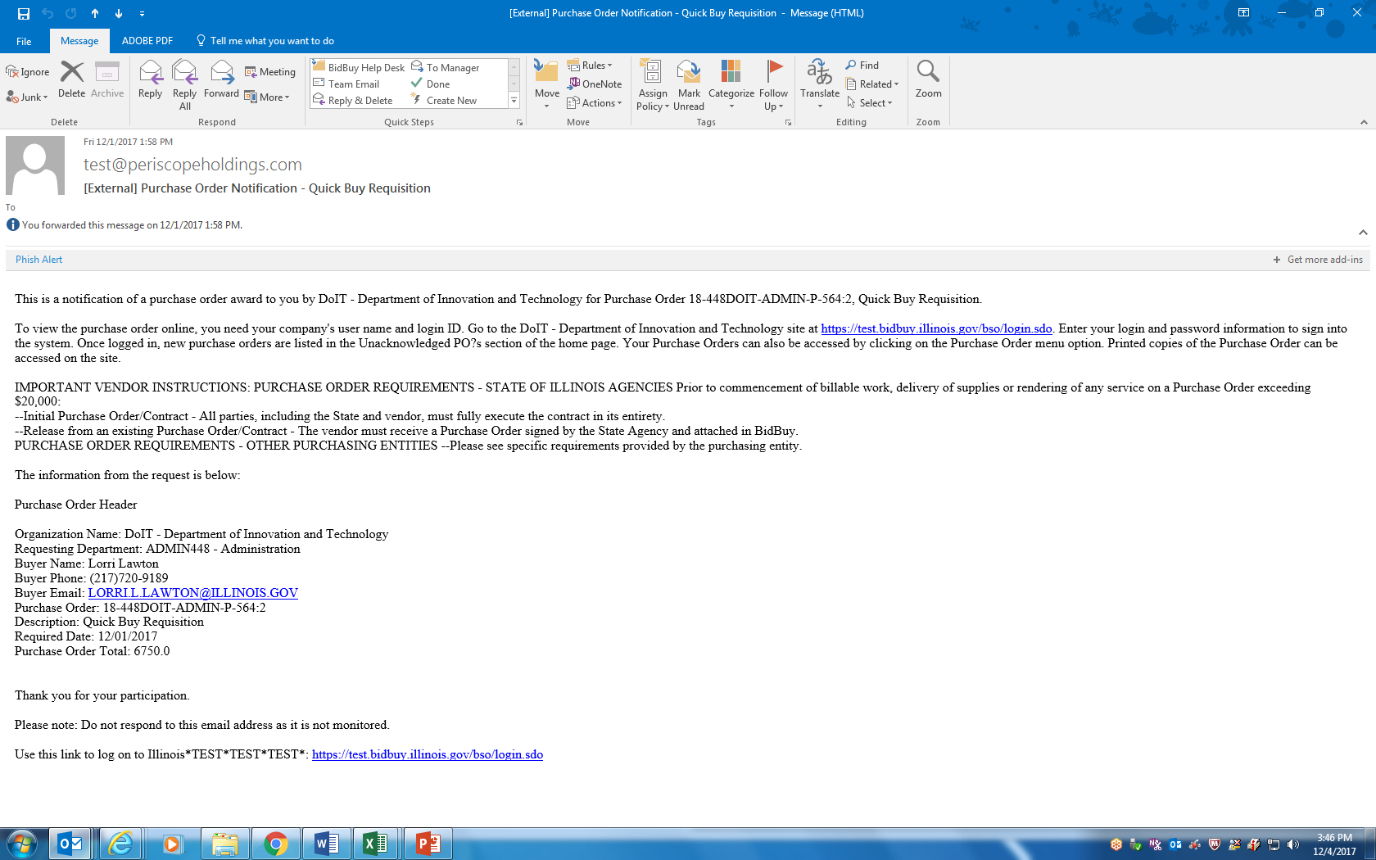
Notification of Purchase Order
After all post-award requirements have been met, the State will finalize the resulting Purchase Order and notify the vendor.
-Original Purchase Order and Release PO
Notes:
BidBuy notifies the vendor that a Purchase Order is available and can be viewed by logging into BidBuy. The email supplies the vendor with the general information they will find on the Purchase Order.

Slide 11
Purchase Order
1. Click PO tab
2. Purchase Order #
3. Acknowledge Receipt of Purchase Order
4. Notify requestor of receipt of PO
Review the PO and select each tab to view detail.
Notes:
When the Purchase Order has been awarded, a PO document can be issued to the vendor electronically. This Purchase Order document can serve as the contract between the state and the vendor. Alternatively, detailed contract documents may also be required. The vendor shall follow any instructions in these documents, which includes executing the PO or contract documents prior to fulfilling the contract. Detailed instructions can be provided in the Notes Tab or the template documents.

Slide 12
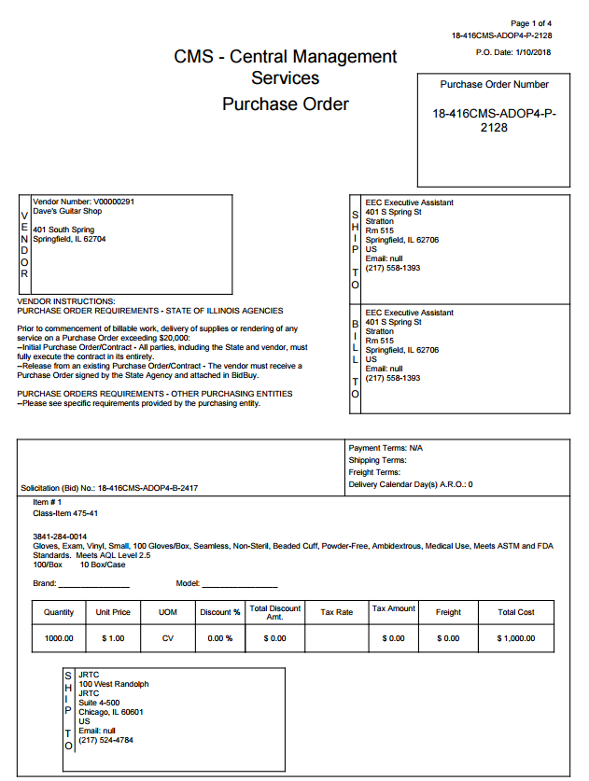
Signed Contract
“Signed Contract” can be a PO, BOA, Stand Alone Contract, etc.

Slide 13
Purchase Order Notification
IMPORTANT VENDOR INSTRUCTIONS: PURCHASE ORDER REQUIREMENTS - STATE OF ILLINOIS AGENCIES Prior to commencement of billable work, delivery of supplies or rendering of any service on a Purchase Order exceeding $20,000:
Initial Purchase Order/Contract - All parties, including the State and vendor, must fully execute the contract in its entirety.
Wet signatures required by all parties
Issuing Agency will coordinate signatures
Executed contract will be attached in BidBuy and is required prior to fulfillment

Slide 14
Purchase Order Notification
Release from an existing Purchase Order/Contract (Over $20,000):
The vendor must receive a Purchase Order SIGNED by the State Agency and attached in BidBuy.
OTHER PURCHASING ENTITIES (Municipalities, School Districts, Park Districts, Universities, etc.)
Please see specific requirements provided by the purchasing entity.

Slide 15
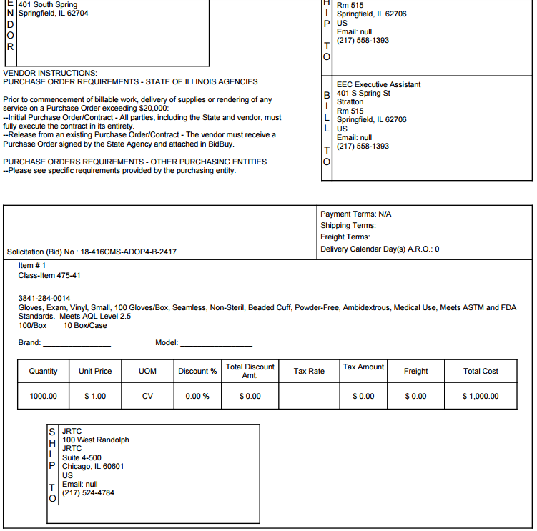
Shipping Address
Header Level
Item Level

Slide 16
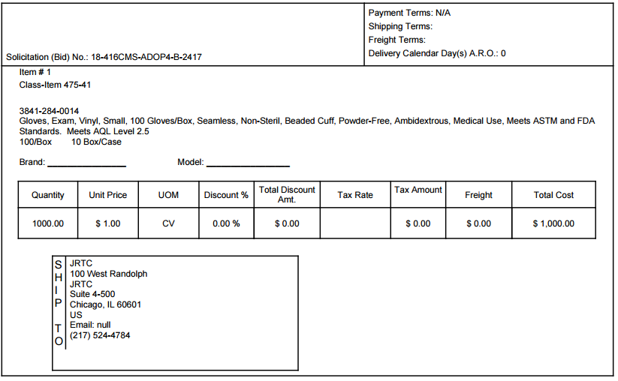
Shipping Address
Item Level

Slide 17
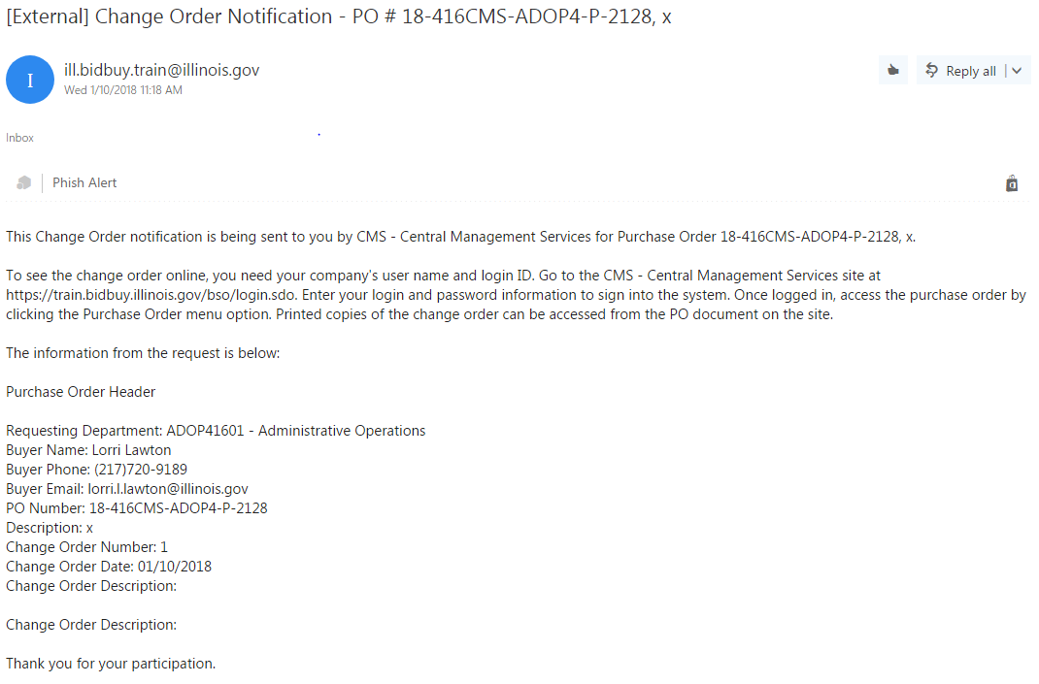
Change Orders
Vendor receives change Order Notification via Email

Slide 18
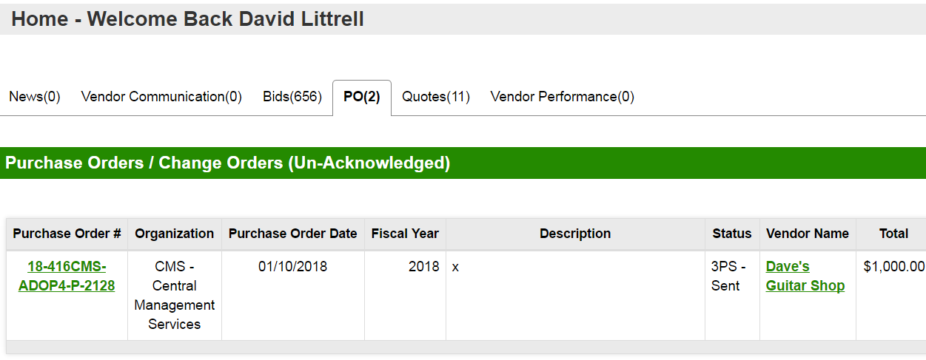
Change Orders
Login to Bidbuy
Acknowledge receipt and Notify Requestor

Slide 19
Change Orders
Vendor may be required to execute additional documents for the change order. Specific instructions will be provided in the change order.
See Attachments for additional change order documents

Slide 20
Vendor Help Desk
Email: il.bidbuy@illinois.gov
Phone: 866-455-2897

Slide 21
Pathway to Procurement: https://www.illinois.gov/cpo/PathwayToProcurement/Pages/BidBuy.aspx : Vendor Manuals and How-to Videos
Vendor Resources

Slide 22
Questions?

