Slide 1
Vendor Training Session #3 Obtaining and Responding to Bids

Slide 2
Objectives
Why BidBuy
Procurement Types: IFB, RFP, Small Purchase, Other
Formal vs. Informal Quotes
Obtaining a Solicitation
Acknowledging Receipt of Bid

Slide 3
Objectives
Responding to a Bid
Paper/Electronic Submittal
Attaching Documents
Revising Quotes/Withdrawing Quotes/Multiple Quotes/Paper Responses
Subcontractors on Quotes
BEP Utilization
Entering Pricing
Term & Conditions
Access Vendor Resources

Slide 4
Why BidBuy?
Simplifies the bid/quote process by allowing electronic submittals.
Reduces paper documentation and records.
Centralizes state procurement communications in a single location.
Allows vendors to easily review open bids, submit bids/quotes and receive awards from a central location.
Allows vendors to review its procurement history.

Slide 5
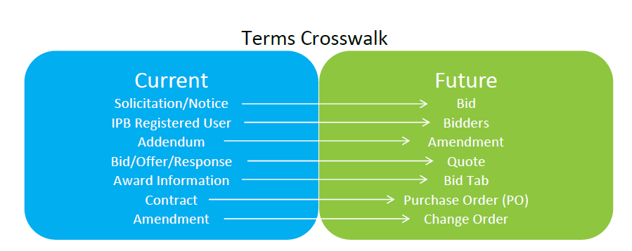
General Overview

Slide 6
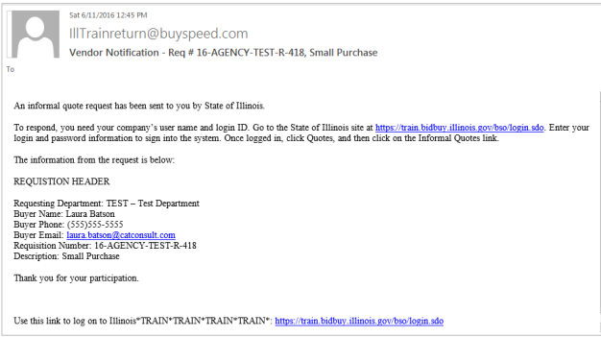
Informal Quotes
The State sends the Vendor an email notification regarding the availability of an informal quote opportunity.

Slide 7
Responding to Informal Quotes
After receiving the informal quote opportunity email, log into BidBuy to respond to the informal quote request.
1. Select Quotes > Informal Quotes
2. Click Create Quote
3. Complete Tabs with required information
General, Items, Address, Terms & Conditions, add any Attachments, etc.
4. Click Save and Exit

Slide 8
Confirmation Email

Slide 9
Viewing only from Login Page

Slide 10
Formal Quotes
1. Select Create Quote
2. Click Yes to acknowledge receipt of the Bid
3. Complete Tabs with required information
General, Items, Questions (if applicable), Subcontractors (if applicable), Terms & Conditions, add any Attachments, etc.
4. On Summary Tab, click Submit Quote

Slide 11
Confirmation Email

Slide 12
Vendor Help Desk
Email: il.bidbuy@illinois.gov
Phone: 866-455-2897

Slide 13
Pathway to Procurement: https://www.illinois.gov/cpo/PathwayToProcurement/Pages/BidBuy.aspx : Vendor Manuals and How-to Videos
Vendor Resources

Slide 14
Questions?

