Slide 1
Vendor Training Session #1 Seller Administrator

Slide 2
Objectives
Understand Why the State is Implementing BidBuy
Navigate in BidBuy
Understand BidBuy Terminology/BidBuy Time
Explain What a Seller Administrator Role Does
Understand and Use the BidBuy Homepage
Create a Seller Administrator Account
Create Accounts for Authorized Vendor Staff
Select NIGP Codes for Vendor Account
Make Updates to the Accounts
Access Resources

Slide 3
What is BidBuy?
CURRENT
Remedy (PBC)
Survey Process (Manual)
Illinois Procurement Bulletin
Procurement File
CPO/SPO Approvals
FUTURE

Slide 4
Why BidBuy?
Simplifies the bid/quote process by allowing electronic submittals.
Reduces paper documentation and records.
Centralizes state procurement communications in a single location.
Allows vendors to easily review open bids, submit bids/quotes and receive awards from a central location.
Allows vendors to review its procurement history.
Notes:
1. Contract history: contracts with activity in the future will be in BidBuy (Masters, renewals, change orders.) Anything with future activity. IPB will be for historical reference only.

Slide 5
Who BidBuy?
All procurements under Chief Procurement Office for General Services
Notes:
Example: IDOT will have some procurements using BidBuy. Construction, for instance will not.

Slide 6
Pathway to Procurement
To view instructional videos on how to register in BidBuy or to refer to Vendor Manuals, please visit https://www.illinois.gov/cpo/PathwayToProcurement/Pages/BidBuy.aspx
3 Videos:
“How to Register in BidBuy”
“Seller Administrator Role”
“How to Register for IPG Vendors Only”
Notes:
Google “CPO-GS” or “Pathway to Procurement IL”

Slide 7
2 Types of Vendor Roles in BidBuy
Seller Administrator: can maintain business information, user profiles, and can invite Associated Organizations to register in BidBuy
This can be changed at any time and there can be multiple Seller Administrators on a single account, though there must always be at least one
Seller Role: search, view, and respond to bid opportunities; search and view active State contracts; and view purchase orders.
Notes:
Seller Administrator: manage the account
Seller: involved in the day-to-day selling to the State (submitting bids, quotes, etc)

Slide 8
Seller Administrator Home Page
Notes:
Maintain Organization Information ‐‐ This option provides the ability to maintain all organizational information including addresses, terms, categories, and commodity codes.
Maintain Users on this Account – This option provides the ability to maintain all users of this account, by searching, adding and updating user information.
Add Users on this Account – This option provides the ability to add users to this account.
Add Associated Organization ‐‐ This option provides the ability to add an Associated Organization or “Doing Business As” to this account.

Slide 9
Seller Home Page

Slide 10
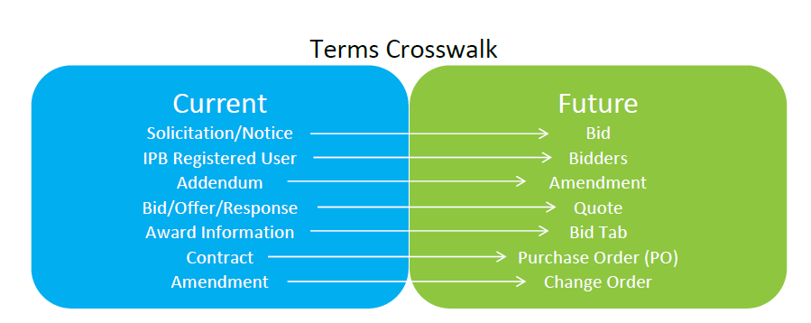
General Overview

Slide 11
Vendor Help Desk
Email: il.bidbuy@illinois.gov
Phone: 866-455-2897

Slide 12
Questions?

